Slide 1
Bond investment strategy
Alper YILDIRIM

Slide 2
Contents
Global Market Outlook
Portfolio Distribution
Portfolio Construction
Risk Considerations
Interest Rate Risk
Long Only
Strategy
Inflation Risk
Credit Risk
Inflation Risk
Geopolitical Risk

Slide 3
Portfolio constructıon

Slide 4
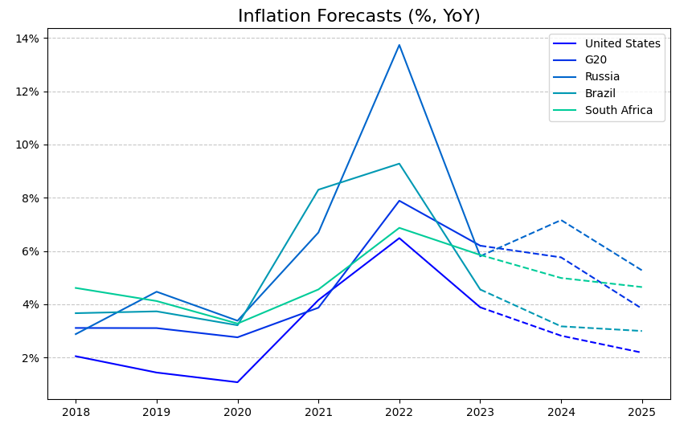
Global market outlook

Slide 5
PLAN FOR PRODUCT LAUNCH
Deploy strategic networks with compelling e-business needs
PLANNING
Synergize scalable e-commerce
MARKETING
Disseminate standardized metrics
DESIGN
Coordinate e-business applications
Foster holistically superior methodologies
LAUNCH
STRATEGY

Slide 6
strategy

Slide 7
PLAN FOR PRODUCT LAUNCH
Deploy strategic networks with compelling e-business needs
PLANNING
Synergize scalable e-commerce
MARKETING
Disseminate standardized metrics
DESIGN
Coordinate e-business applications
Foster holistically superior methodologies
LAUNCH
STRATEGY

Slide 8
RISK CONSIDERATIONS
ANNUAL REVENUE GROWTH

Slide 9
Interest rate rısk
- duration, convexity, etc.

Slide 10
Lıquıdıty rısk

Slide 11
Credıt rısk

Slide 12
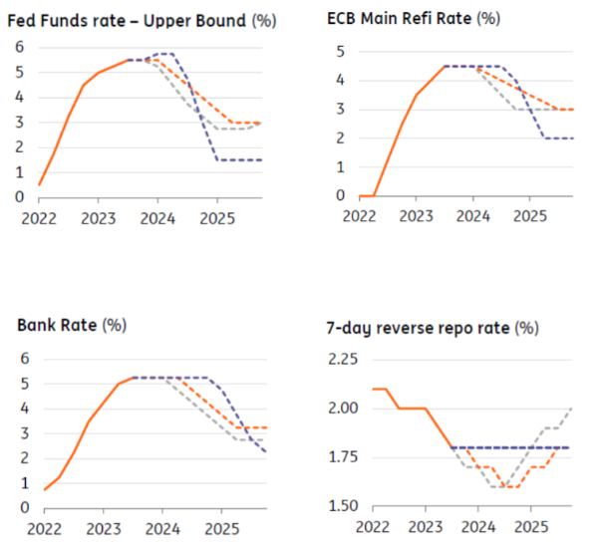
Inflatıon rısk
Even though risks persist, inflation started to cool down
Starting from 2nd half of 2024, interest rate cuts may start
Source: OECD Economic Outlook, November 2023
Source: ING Global Outlook 2024, November 2023

Slide 13
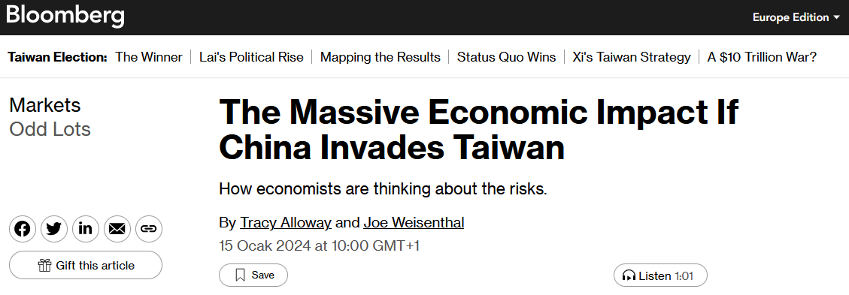
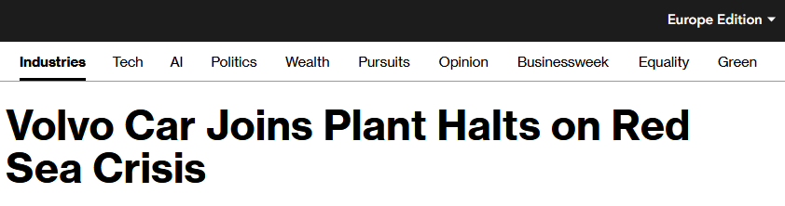
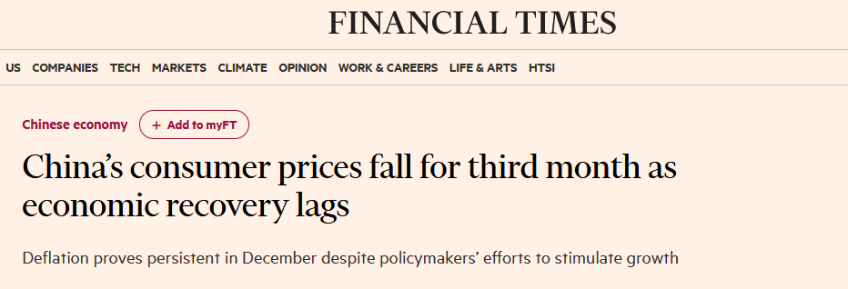
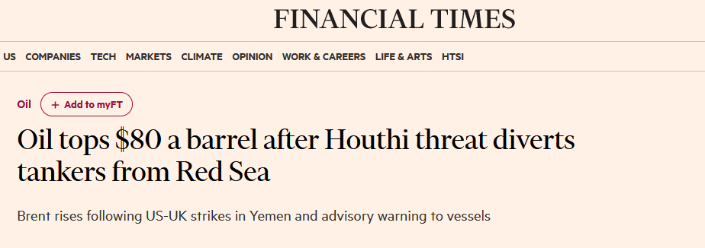
Geopolıtıcal rısk
Avoid Chinese and Middle East Region bonds
Rising political and military tensions may eventually lead economic downturn and declining markets

Slide 14


AGENDA
INTRODUCTION
PRIMARY GOALS
AREAS OF GROWTH
TIMELINE
SUMMARY

Slide 15
Rısk consıderatıons
Interest rate risk
Inflatıon risk
Credıt risk
Lıquıdıty rısk

Slide 16

INTRO
At Contoso, we empower organizations to foster collaborative thinking to further drive workplace innovation. By closing the loop and leveraging agile frameworks, we help business grow organically and foster a consumer-first mindset.

Slide 17
PRIMARY GOALS
ANNUAL REVENUE GROWTH

Slide 18
QUARTERLY PERFORMANCE

Slide 19
AREAS OF GROWTH
 | B2B | Supply chain | ROI | E-commerce
Q1 | 4.5 | 2.3 | 1.7 | 5.0
Q2 | 3.2 | 5.1 | 4.4 | 3.0
Q3 | 2.1 | 1.7 | 2.5 | 2.8
Q4 | 4.5 | 2.2 | 1.7 | 70

Slide 20
BUSINESS OPPORTUNITIES ARE LIKE BUSES. THERE'S ALWAYS ANOTHER ONE COMING.
“
”
Richard Branson

Slide 21








MEET OUR EXTENDED TEAM
Takuma Hayashi
Mirjam Nilsson
Flora Berggren
Rajesh Santoshi
President
Chief Executive Officer
Chief Operations Officer
VP Marketing
Graham Barnes
Rowan Murphy
Elizabeth Moore
Robin Kline
VP Product
SEO Strategist
Product Designer
Content Developer

Slide 22
PLAN FOR PRODUCT LAUNCH
Deploy strategic networks with compelling e-business needs
PLANNING
Synergize scalable e-commerce
MARKETING
Disseminate standardized metrics
DESIGN
Coordinate e-business applications
Foster holistically superior methodologies
LAUNCH
STRATEGY

Slide 23
TIMELINE
SEP 20XX | Synergize scalable e-commerce
NOV 20XX | Disseminate standardized metrics
JAN 20XX | Coordinate e-business applications
MAR 20XX | Foster holistically superior methodologies
MAY 20XX | Deploy strategic networks with compelling e-business needs

Slide 24




AREAS OF FOCUS
B2B MARKET SCENARIOS
Develop winning strategies to keep ahead of the competition​
Capitalize on low-hanging fruit to identify a ballpark value​
Visualize customer directed convergence
CLOUD-BASED OPPORTUNITIES
Iterative approaches to corporate strategy​
Establish a management framework from the inside

Slide 25



HOW WE GET THERE
ROI
NICHE MARKETS
SUPPLY CHAINS
Envision multimedia-based expertise and cross-media growth strategies
Visualize quality intellectual capital
Engage worldwide methodologies with web-enabled technologies
Pursue scalable customer service through sustainable strategies
Engage top-line web services with cutting-edge deliverables
Cultivate one-to-one customer service with robust ideas
Maximize timely deliverables for real-time schemas

Slide 26

SUMMARY
At Contoso, we believe in giving 110%. By using our next-generation data architecture, we help organizations virtually manage agile workflows. We thrive because of our market knowledge and great team behind our product. As our CEO says, "Efficiencies will come from proactively transforming how we do business."

Slide 27
THANK YOU
Mirjam Nilsson
mirjam@contoso.com
www.contoso.com

